Slide 1
HEART DISEASE PREDICTION USING DATA MINING
Guide Name: Mr.Srikanth Reddy
Team Members: A.JayaVani (16881A1201)
Rakshitha Somadri (16881A1239)
Devaraneni Shresta (16881A1213)

Slide 2
INTRODUCTION
Heart Disease is one of the major causes of increased mortality rate in India.
Data mining techniques are helpful for early diagnosis of heart disease in a patient.
The system analyzes the patient’s data and derives the patterns from it.
These patterns are used to predict whether the patient is having the heart disease or not.

Slide 3
Overview
1. To predict how likely a person is to get heart disease using data mining techniques.
2. The prediction model is built using the dataset which is predefined.
3.This database contains 76 attributes, but all published experiments refer to using a subset of 13 of them.
4.The "goal" field refers to the presence of heart disease in the patient.

Slide 4
Aim
The aim of the project is to compare and contrast the different machine learning algorithms applied on the heart disease data-set. It is to improve the accuracy of the result prediction capability.
The system collects the values from the user and predicts if the person is likely to have a heart disease or not.

Slide 5
What are those 13 attributes?
Age
Gender(0=Female,1=Male)
Chest pain type
Resting blood pressure
Cholesterol
Fasting blood sugar
Slope
Oldpeak
Exercise induced angina
Maximum heart rate acheived
Number of major vessels
Thalassemia
Resting electrocardiographic

Slide 6
Advantages:
The health care industries collect huge amounts of data that contain some hidden information, which is useful for making effective decisions. For providing appropriate results and making effective decisions on data, some advanced data mining techniques are used. The obtained results have illustrated that the designed diagnostic system can effectively predict the risk level of heart diseases.

Slide 7
Difficulties faced during the project:
The prediction system must be accurate so as to provide correct results to the user.
Although algorithms are implemented they may not produce exact results at times.
Thus to provide accurate results efficiently the model has to be increased by comparing the algorithms and predicting the correct report.

Slide 8
List of algorithms used
Random forest classifier
Decision tree
Support Vector Machine
Naive bayes
XGB classifier

Slide 9
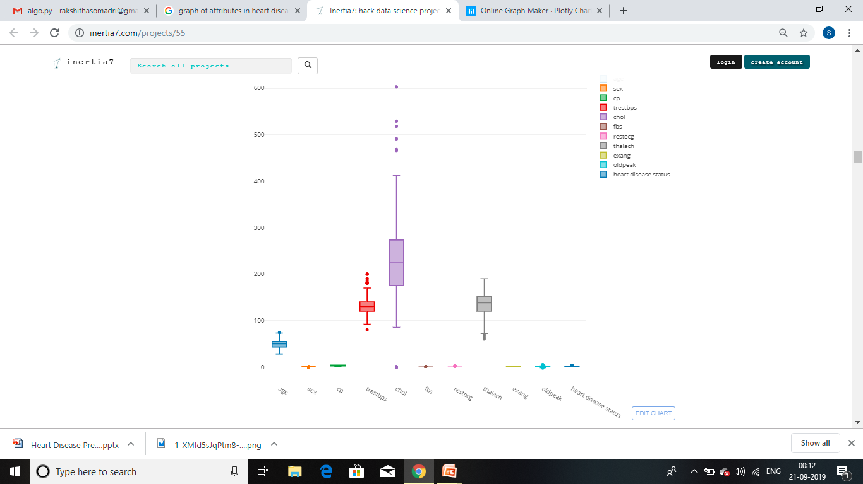
Graphical representation of the values in a dataset

Slide 10
Relevant Papers:
Detrano, R., Janosi, A., Steinbrunn, W., Pfisterer, M., Schmid, J., Sandhu, S., Guppy, K., Lee, S., & Froelicher, V. (1989). International application of a new probability algorithm for the diagnosis of coronary artery disease. American Journal of Cardiology, 64,304--310. [Web Link]
David W. Aha & Dennis Kibler. "Instance-based prediction of heart-disease presence with the Cleveland database." [Web Link]
Gennari, J.H., Langley, P, & Fisher, D. (1989). Models of incremental concept formation. Artificial Intelligence, 40, 11--61. [Web Link]

Slide 11
Thank You!

